Slide 1

Lyft Earnings Commitment Verification
A Caleb Hutley Analytical Project
This Photo by Unknown Author is licensed under CC BY-SA

Slide 2

Agenda
Purpose
Understanding Lyft’s Earning Commitment Policy
Methodology
Calculations
Conclusion
Reservations
Future Analysis Points

Slide 3
Purpose
The purpose of this project is to verify the Lyft Earnings Commitment Guarantee using personally recorded data

Slide 4

Understanding lyft’s Earnings Commitment
“On a weekly basis, drivers will earn 70% or more of passenger payments after external fees are deducted.”
“Note: Drivers will always receive 100% of tips, adjustments, benefits, and tolls, as they aren't subject to external fees or Lyft's fee.”
https://help.lyft.com/hc/en-us/all/articles/9785135090-earnings-commitment

Slide 5

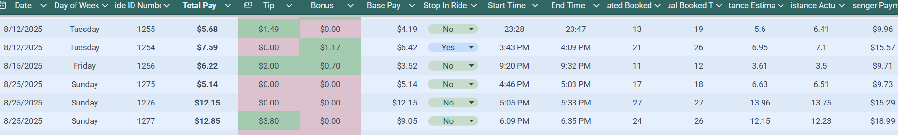
Methodology
Data is being collected via my personal Lyft rideshare data. I am collecting information in a Google sheets spreadsheet which is being converted to a CSV file which is cleaned and analyzed using Python.
I continue to update and maintain the file Lyft_Data_V1.csv with 15 attributes including but not limited to payment information, ride distance, date and time.
As my research continues, I may add more attributes for future analysis. This data is evolving.

Slide 6
Importing of Data
Python Code

Slide 7
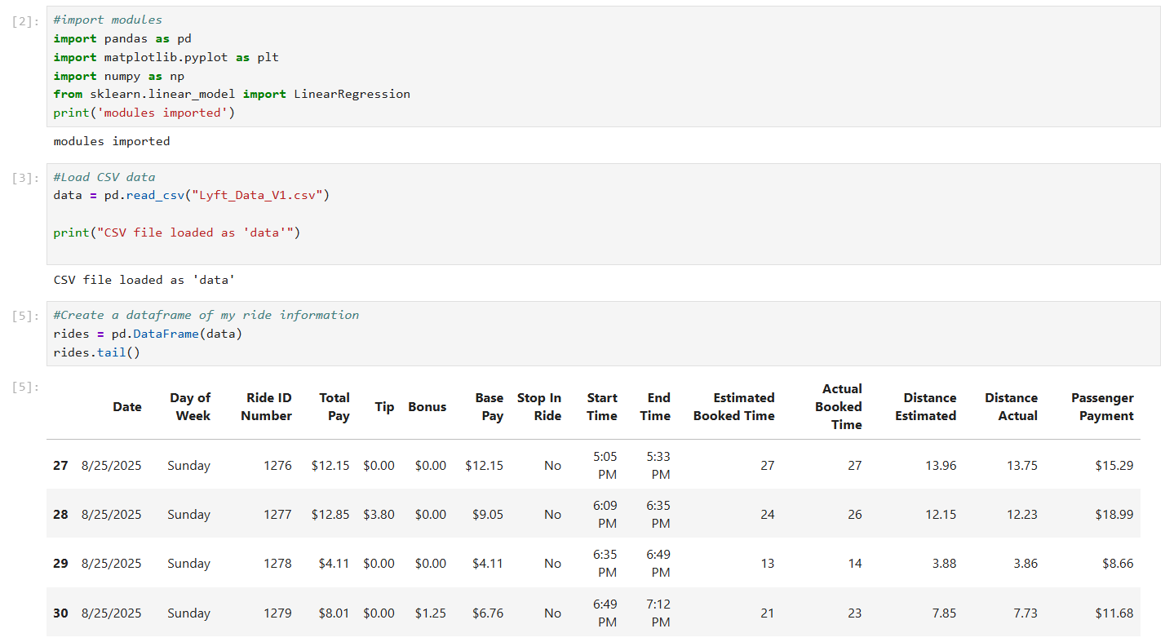
Importing
Import Libraries
Import CSV file
load as a Dataframe

Slide 8
Loaded DataFrame
Note: symbols in the columns will prevent from accurate calculations in formulas. These will be removed before continuing.

Slide 9
Cleaning of Data
Python Code

Slide 10
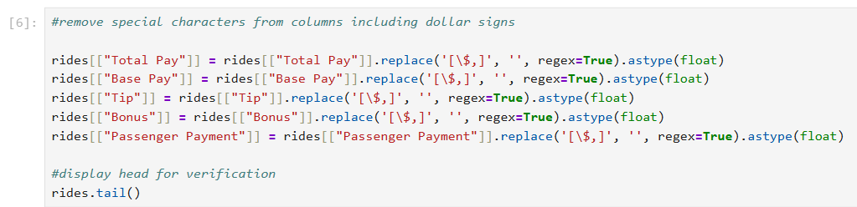
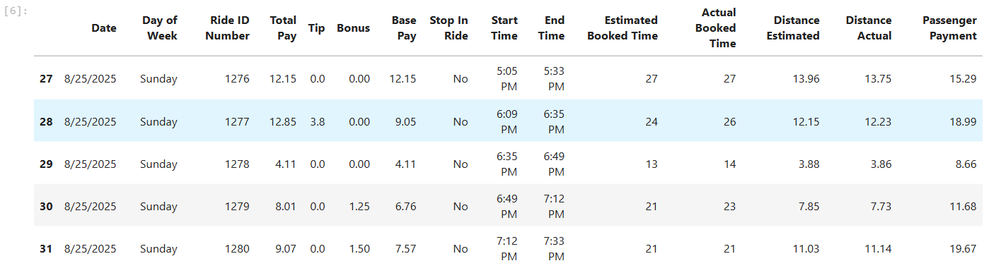
Cleaning
Removing special characters from columns with currency. Formatted as floats.
Visualization of the new DF tail to make sure “$” were successfully removed

Slide 11
Calculations
Python Code

Slide 12

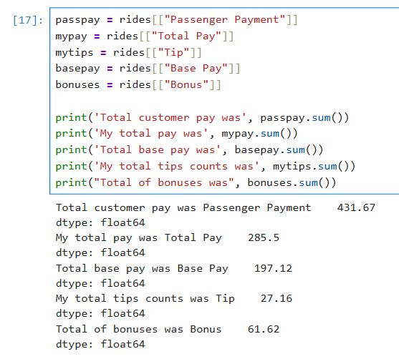
Calcuclations
From my last 31 rides (32 exclusive), I have made:
$197.12 in base pay
$61.62 in Bonuses
$27.16 in tips
Total of $285.50
The total payment of passengers before Lyft fees was $431.67

Slide 13
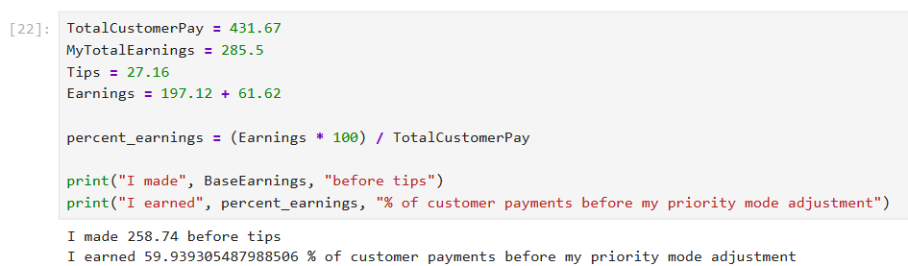
Before adjustments
Using cross multiplication to find percentages

Slide 14
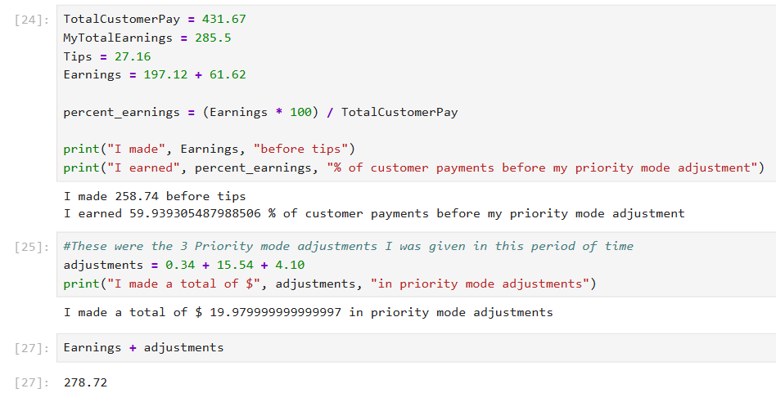
Priority Mode Adjustments
I received 3 adjustments in this time period.
My earnings after adjustments was $278.72 (Still excluding tips)

Slide 15
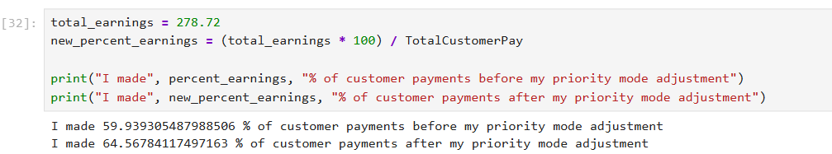
Earning percentages
Cross multiply to find the new percentage of my earnings after the priority mode adjustment is included.

Slide 16
Conclusion
Before Adjustments I made 59.93% of what the customer paid
adjustments I made 64.57% of what the customer paid
I did Not make a minimum of 70% of customer payments

Slide 17
Reservations
Although I did not receive 70% minimum of customers payments, it is stated that drivers will receive 70% AFTER external Fees are deducted.
Lyft Guarantees that “If a driver's earnings are below 70% when the week ends, they’ll get paid an earnings adjustment to make up the difference.“ It is also possible Lyft is in the process of paying me another adjustment for my recent rides.

Slide 18
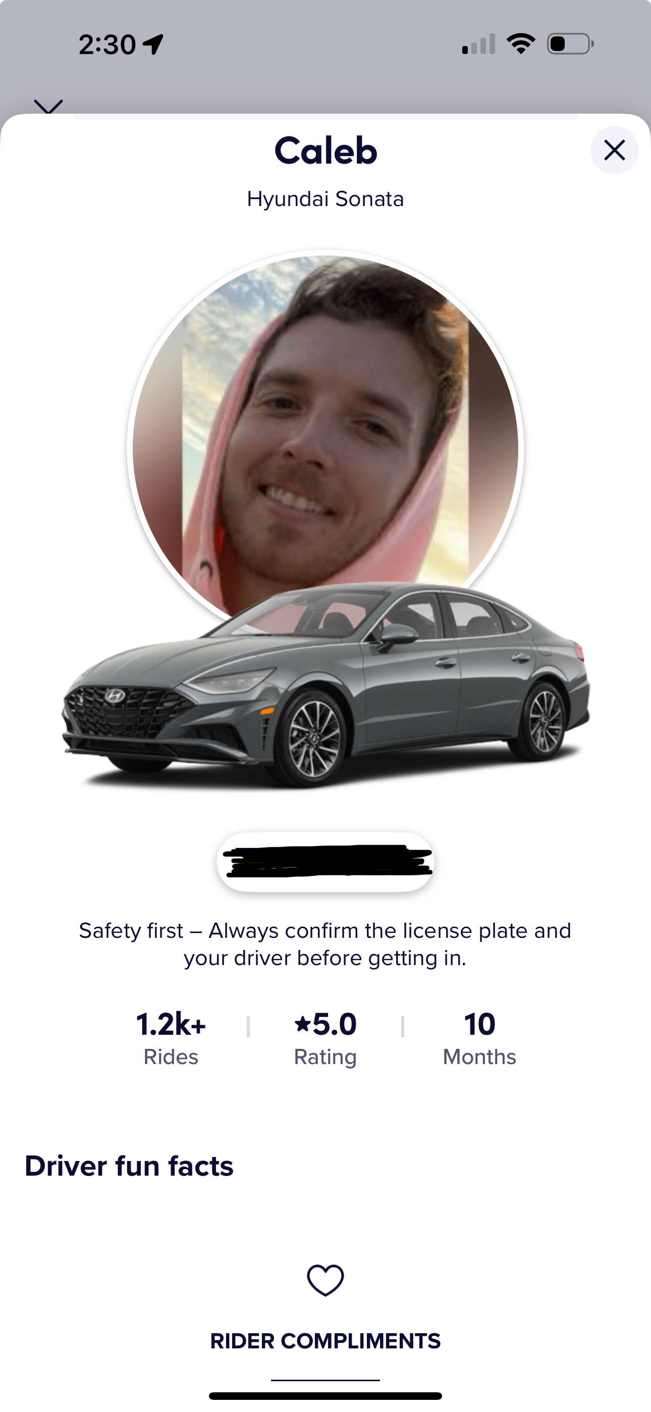
Thank you
Caleb Hutley
cbhutley@gmail.com
https://github.com/cbhutley/rideshare-data-analysis.git
www.linkedin.com/in/caleb-hutley

Slide 19
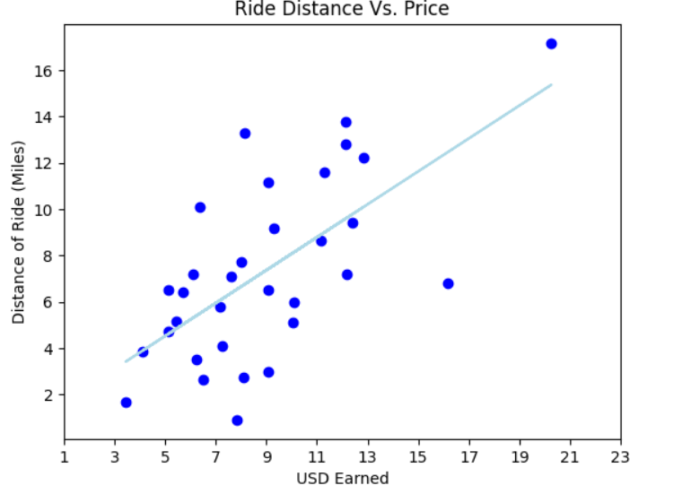
Future Analysis Projects
Bonus Zones and Times
Challenges
Tier points
Priority Mode
Rewards
Lyft’s Profits
XL and Comfort Rides

